Slide 1

Ship Arrests

Slide 2
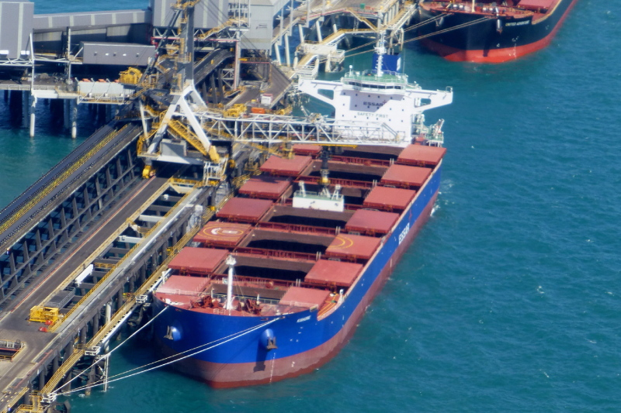
Ship Arrests
‘A vessel owned by India’s Essar Shipping carrying iron ore from Brazil to China was arrested in Singapore on Sunday due to a dispute with a bunker fuel supplier, according to the city-state’s Supreme Court website.
The 106,438-deadweight tonne vessel Kishore was arrested by the Supreme Court sheriff because of a dispute with Singapore-based Bunker House Petroleum.
The Cyprus-flagged dry bulk carrier, built in 2012, was arrested by solicitor Oon & Bazul LLP, according to the sheriff’s arrest list posted on the Supreme Court’s website.
A shipping line spokesman told Reuters that he expected the vessel to be released this week.’
(Maritimeintel.com, November 2013)

Slide 3
Why arrest a ship?
Civil claims (we leave aside criminal issues, for which ships may also be arrested)
Maritime transport gives rise to claims
E.g.: damages from collision, cargo damages, unpaid debts such as bunker fuel etc.
Ships are on the move

Slide 4
Why arrest a ship?
Often hard to figure out who is owner/manager/charterer
In maritime (common) law the claim is supposed to be against the ship
So, arrest the ship!
If you can…

Slide 5
International Conventions
1952 Brussels Convention on Arrest of Ships = most important one, 70 + Member States
1999 Convention seeks to improve (e.g. environmental claims), entered into force but not signed by many states yet + not by the big maritime nations)
Conservatory arrest
Unification
Fast and easy procedure
Must be related to (listed) maritime claim
Tries to balance interests of ship owners and claimants
Kuwait did not ratify Convention, but KML provisions on arrest inspired by it.

Slide 6
Wrongful arrest
If for any reason (claim does not relate to the ship, warranty has been put before arrest etc., claim is not substantiated) the arrest is considered wrongful
Can lead to high losses + liability on claimant
1952 Convention gives free hand to state parties to decide on remedies
1999 Convention suggests to ask claimant for security (e.g. bank guarantee) before arrest

Slide 7

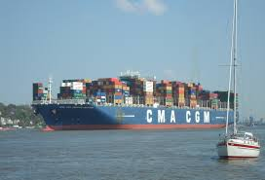
Release
Upon submitting security (bank/insurance/P&I) ship can sail.

Slide 8
Issues (differ per jurisdiction)
Can a sister ship be arrested?
Can a ship be arrested pending proceedings in another country?

Slide 9
How to arrest a ship?
You have to know her movements
cf. lloydslistintelligence.com
Now, if we know she is coming to Kuwait this week, what can we do?

Slide 10
Seizure (=arrest) of the ship in KML
Kuwait ≠ party to any convention (non of the Gulf states is)
Art. 73-87 KML deal with ship arrest
Divided in precautionary (conservatory) seizure (art. 73-78)/executive seizure (art. 79-87)

Slide 11
Conservatory ship arrest in KML
Court order needed
KML does NOT deal with question of jurisdiction (competence of court to deal with the matter)
For this: Civil and Commercial Proceedings Law (art. 23/24)
Judge presiding at Chamber of Urgent Matters of General Court decides on the urgency: Jurisdiction? Maritime claim as listed in art. 73?

Slide 12
Conservatory ship arrest in KML
If yes, arrest order granted
Claimant must notify defendant + port authorities within 8 days
Claimant must start proceedings on the merits within 15 days after arrest
Ship must be released upon security for the amount claimed (and not for the value of the arrested ship)

Slide 13
Conservatory ship arrest in KML
Art. 74: in principle sister ship arrest allowed, except when disputes re property/mortgage of the ship
Liable if arrest turned out wrongful, but no security from arrestor required on beforehand (not in KML)

Slide 14
Executive ship arrest in KML
Art. 79-87
Rules on sales/auction in case ship is ‘executed’

